Slide 1
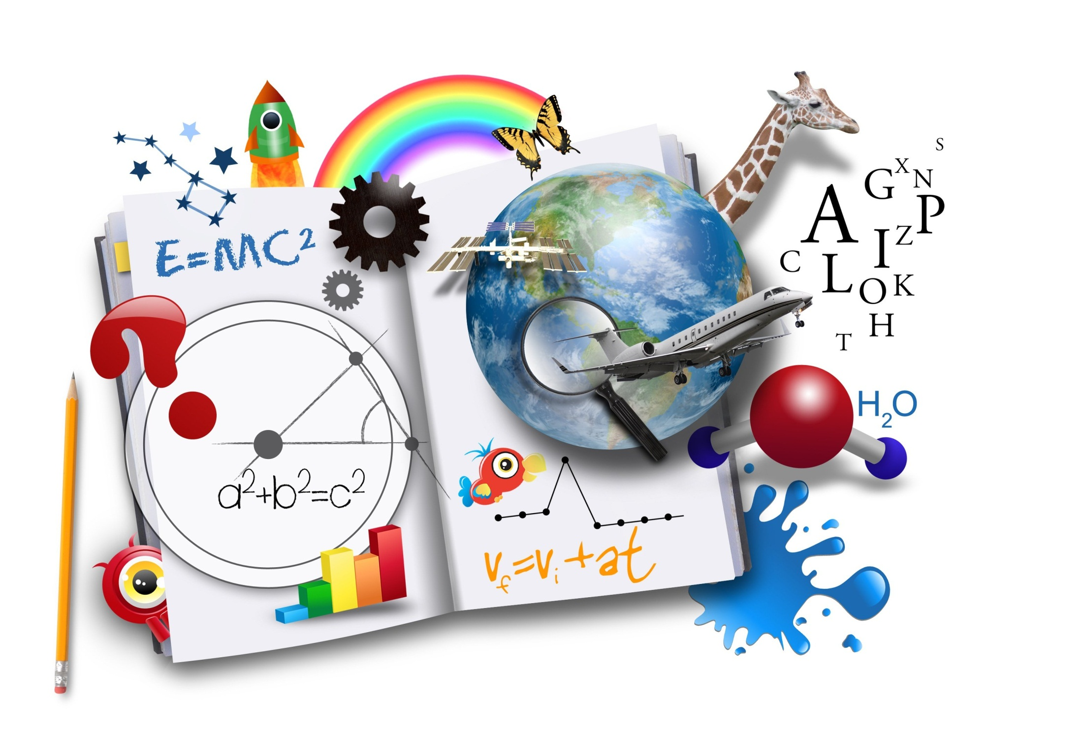
QUIZ
QUIZ
“MATHS RACE”
11th Grade
Math Races
Подготовлена учителем английского языка
МБОУ «Лицей г. Уварово им. А. И. Данилова»
Спицыной Светланой Александровной

Slide 2
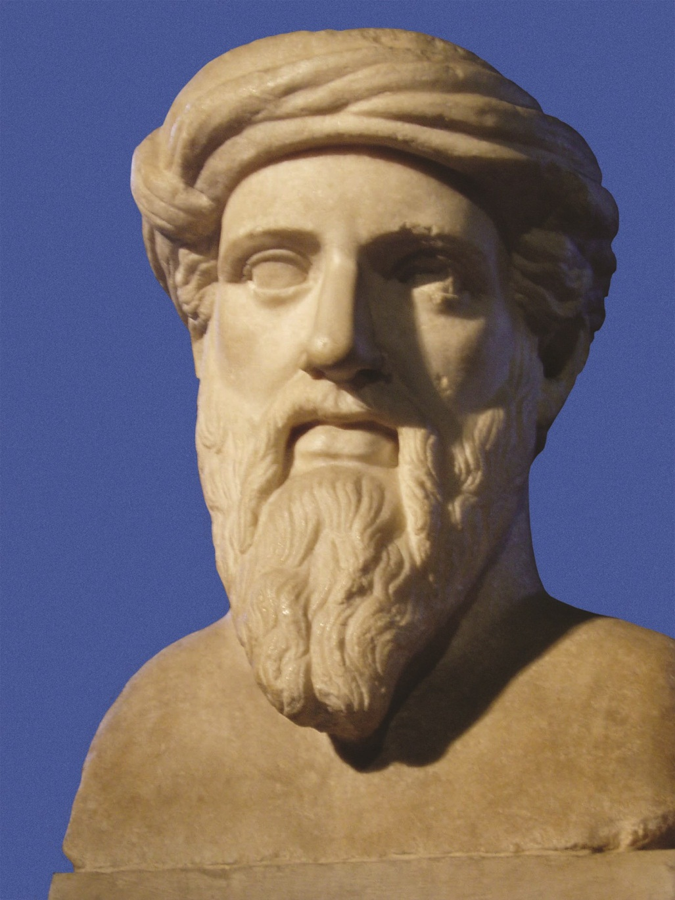
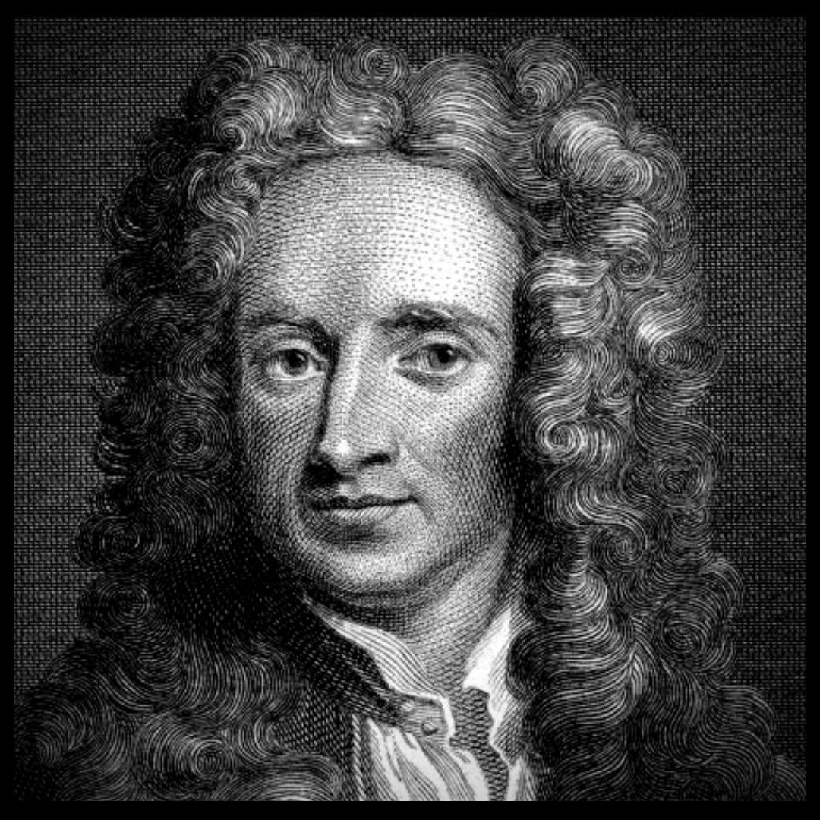
Pythagoras
Isaaс Newton

Slide 3
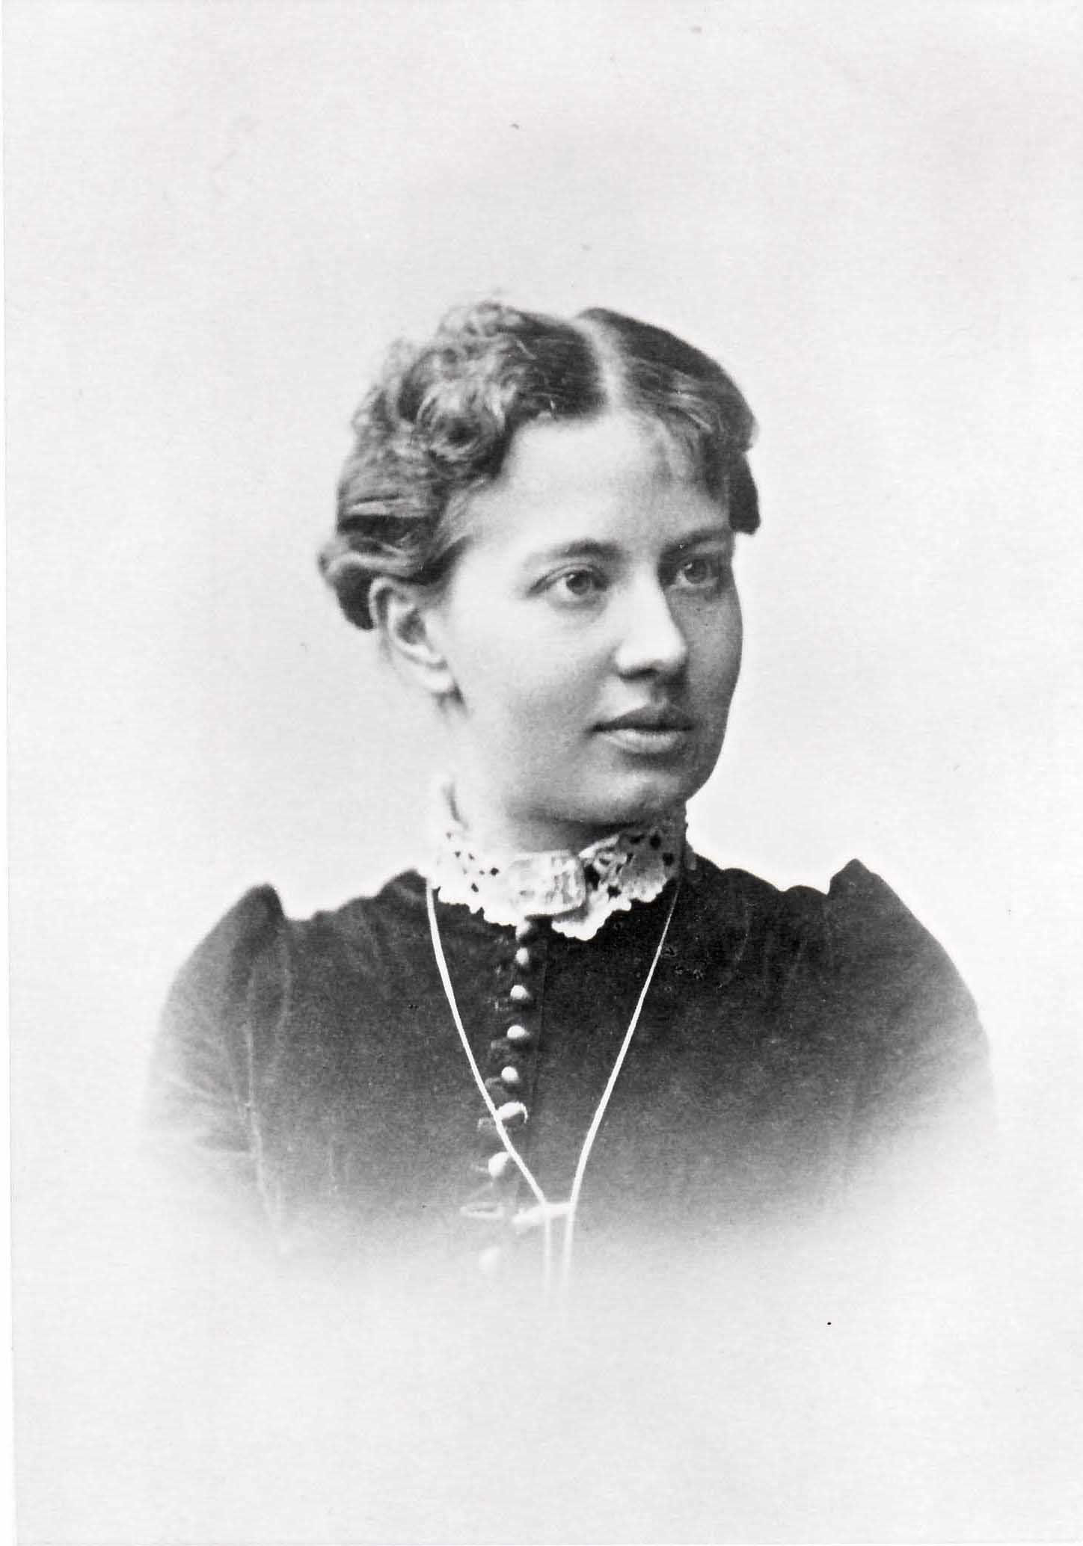
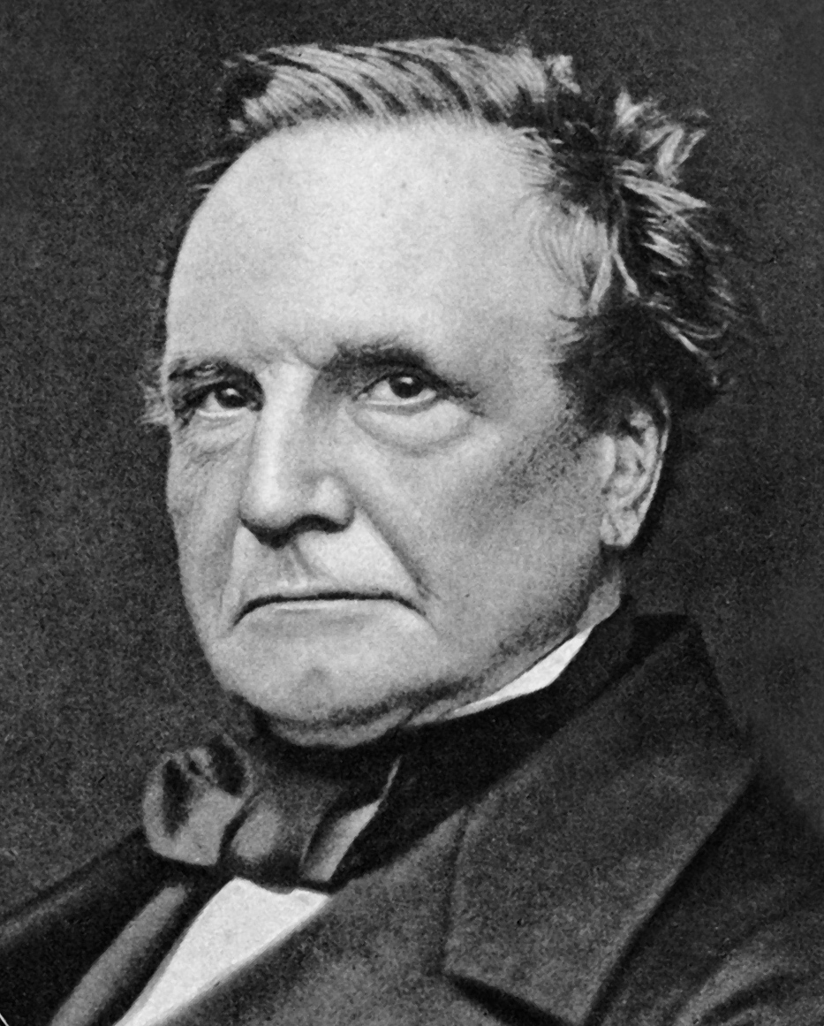
Sofya Vasilyevna
Kovalevskaya
Charles Babbage

Slide 4
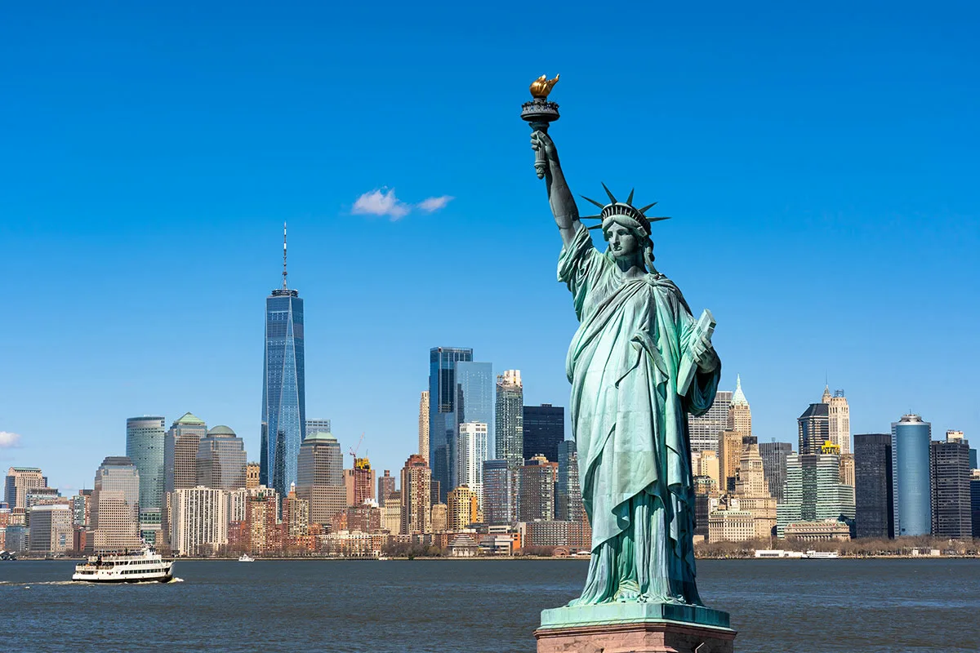
THE STATUE OF LIBERTY
1 | Name of the monument | Statue of Liberty
2 | Location | Liberty Island
3 | Built between | 1884-1886
4 | Gift from | France
5 | Weight | 225 tons (excluding the pedestal)
6 | Height | 45 m/metres
7 | Length | Foot: 7 m/metres Hand: 5 m/metres Ear: 1 m/metre Mouth: 1m/metre

Slide 5
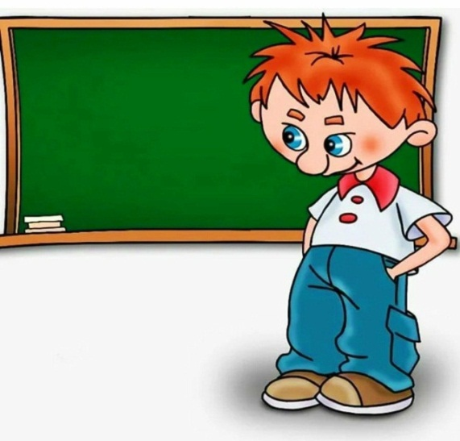
0.5+4.3 =
23×4 =
(26 -1) ×7 =
672: 8 =
6.03+ 0.1 =
38×5 =
(45 -5) ×3 =
354: 3 =
4.8
92
175
84
6.13
190
420
118
1.72 +6.01=
52×9 =
(88-8) ×9 =
476:7 =
9.08 + 0.04 =
44× 6=
(93-10) ×6
855: 9 =
7.73
468
720
68
9.12
264
415
95

Slide 6
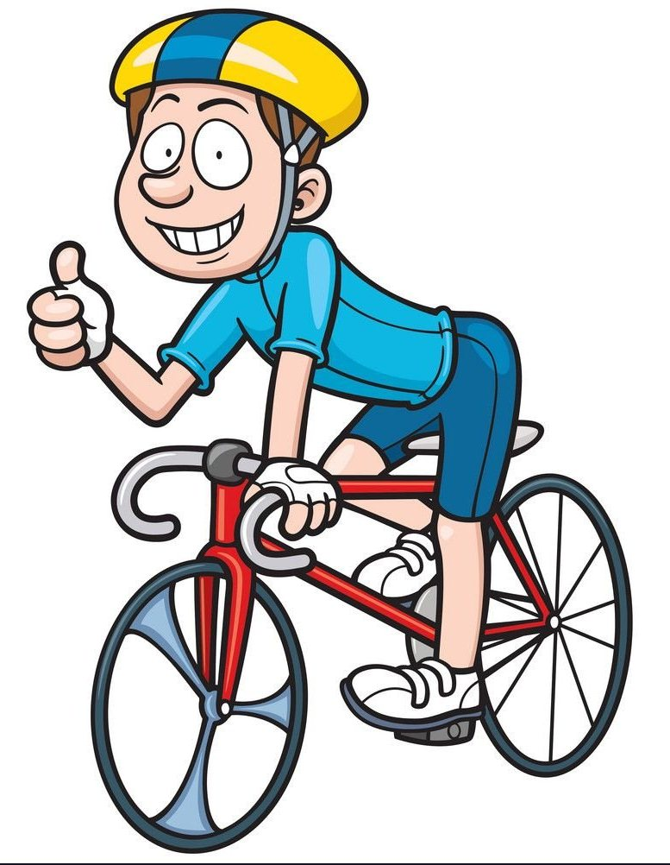
How many bikes?
The other day I counted 7 cycle riders and 19 cycle wheels as they passed by my house. How many bicycles and tricycles passed by?
2 cyclists (4 wheels) and 5 tricycle riders (15 wheels)

Slide 7
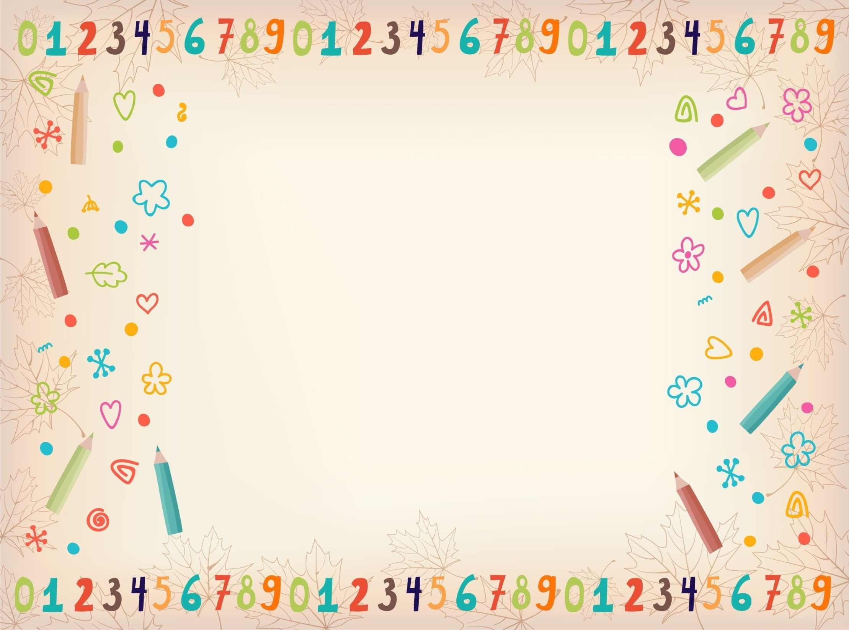
The sister is 5 years old than her brother. How old will she be older than her brother in 7 years?
Answer: In 5 years
Answer: 2 kg
A hen standing on one leg weighs 2 kg. How much does a chicken standing on two legs weigh?

Slide 8
Crossword: What number am I?

Slide 9
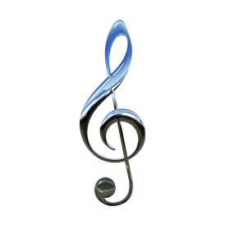
Musical pause

